Slide 1
2 3 trees
Dr. Yasir | Programming Domain

Slide 2
2-3 Tree is also a height balanced tree,
2–3 tree is a tree data structure, where every node with children (internal node) has either two children (2-node) and one data element or three children (3-nodes) and two data elements.
A 2–3 tree is a B-tree of order 3. Nodes on the outside of the tree (leaf nodes) have no children and one or two data elements.
2–3 trees were invented by John Hopcroft in 1970.
Notes:
Insert a map of your country.

Slide 3
properties
Nodes with two children are called 2-nodes. The 2-nodes have one data value and two children
Nodes with three children are called 3-nodes. The 3-nodes have two data values and three children.
Data is stored in sorted order.
It is a balanced tree.
All the leaf nodes are at same level.
Each node can either be leaf, 2 node, or 3 node.
Always insertion is done at leaf
Notes:
Insert a map of your country.

Slide 4
search
To search a key K in given 2-3 tree T, we follow the following procedure: Base cases:
If T is empty, return False (key cannot be found in the tree).
If current node contains data value which is equal to K, return True.
If we reach the leaf-node and it doesn’t contain the required key value K, return False.
Notes:
Insert a map of your country.

Slide 5
Recursive Calls:
If K < currentNode.leftVal, we explore the left subtree of the current node.
Else if currentNode.leftVal < K < currentNode.rightVal, we explore the middle subtree of the current node.
Else if K > currentNode.rightVal, we explore the right subtree of the current node.
Notes:
Insert a map of your country.

Slide 6
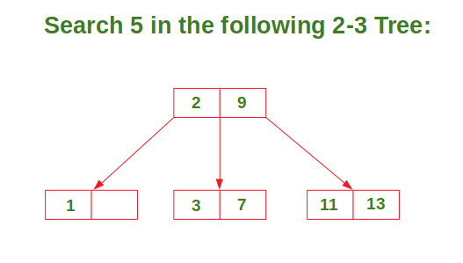
Notes:
Insert a map of your country.

Slide 7
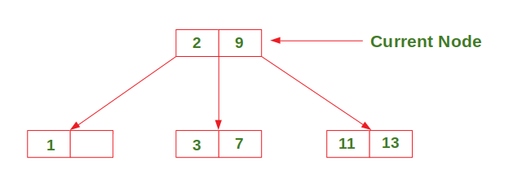
Notes:
Insert a map of your country.

Slide 8
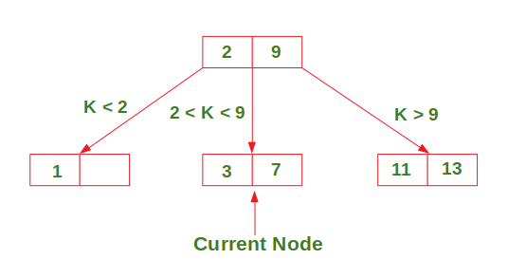
Notes:
Insert a map of your country.

Slide 9
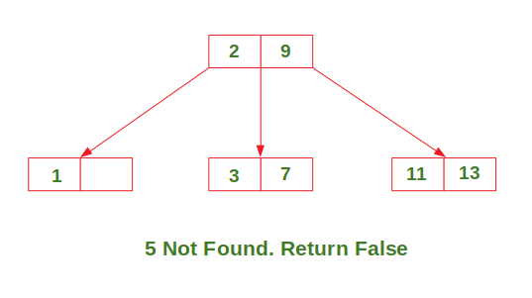
Notes:
Insert a map of your country.

Slide 10
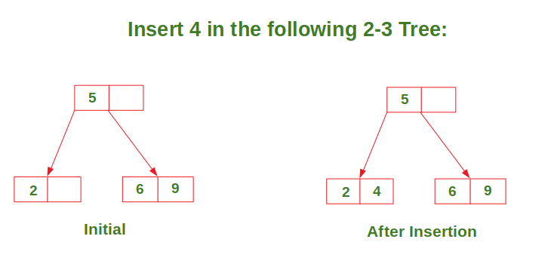
Insertion
Case 1: Insert in a node with only one data element
Notes:
Insert a map of your country.

Slide 11
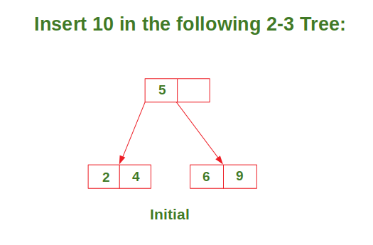
Case 2: Insert in a node with two data elements whose parent contains only one data element.
Notes:
Insert a map of your country.

Slide 12
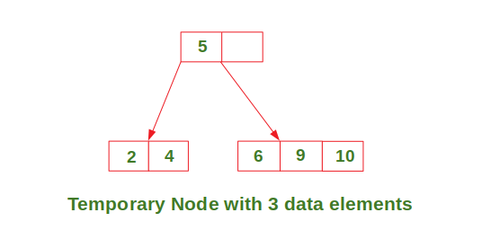
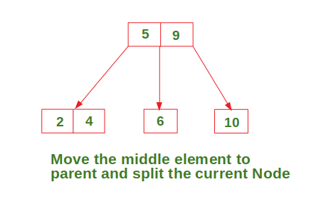
Notes:
Insert a map of your country.

Slide 13
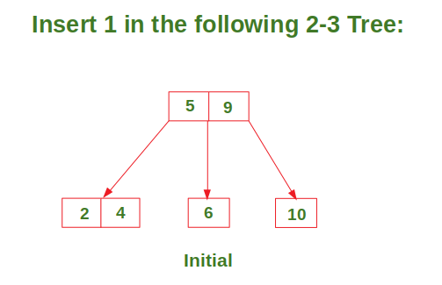
Case 3: Insert in a node with two data elements whose parent also contains two data elements
Notes:
Insert a map of your country.

Slide 14
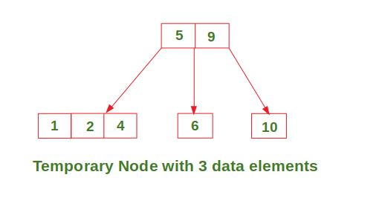
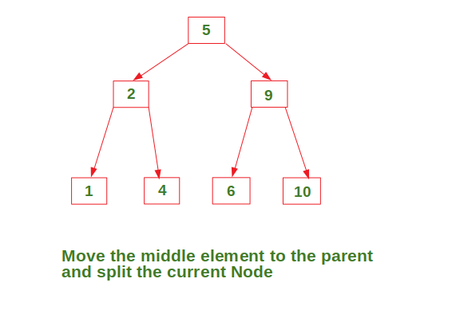
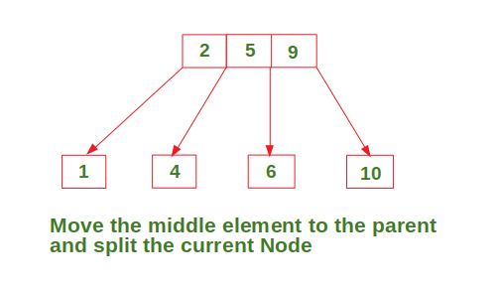
Notes:
Insert a map of your country.

Slide 15
Notes:
Insert a map of your country.

Slide 16
In Deletion Process for a specific value:
To delete a value, it is replaced by its in-order successor and then removed.
If a node is left with less than one data value then two nodes must be merged together.
If a node becomes empty after deleting a value, it is then merged with another node.
Notes:
Insert a map of your country.

Slide 17
Deletion case1
Simply delete
Delete 9
5
5
2
6 9
2
6
Notes:
Insert a map of your country.

Slide 18
Case 2 delete and merge
Delete 80
Merge 60 and 80
Pull parent
50 70
50
40
60
80
40
60 70
Notes:
Insert a map of your country.

Slide 19
Case 3 borrowing
Delete 60
Borrow values from left or right( here borrow right)
Don’t bollow value directly, pull value from parent down
50 70
40
60
80 90
50 80
40
70
90
Notes:
Insert a map of your country.

Slide 20
Notes:
Insert a map of your country.

